Slide 1
Quick Response Quality Control — Shogun
Become the plant-wide deployment lead who installs QRQC at scale and builds the coach bench that sustains it.
Deploying the routine across the plant, end to end.
Cultural Change Index · QRQC PMO · baseline + capacity plan · 4-phase roadmap · deployment Gantt · 4-tier governance · failure-mode recovery · Train-the-Trainers · certification grids
leantrainings.com

Slide 2
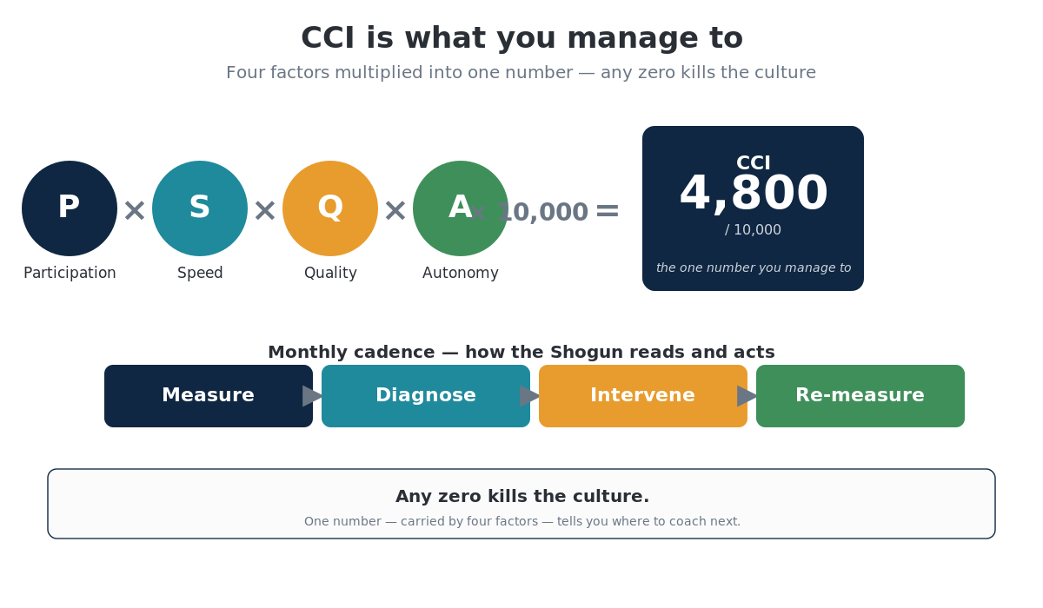

Slide 3
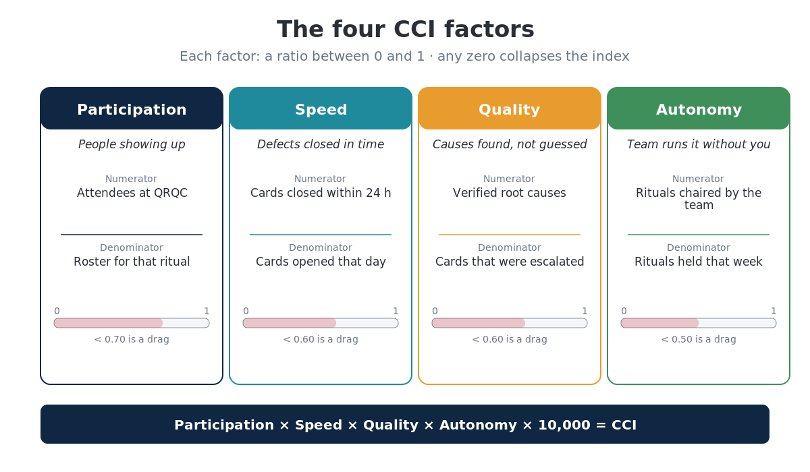

Slide 4
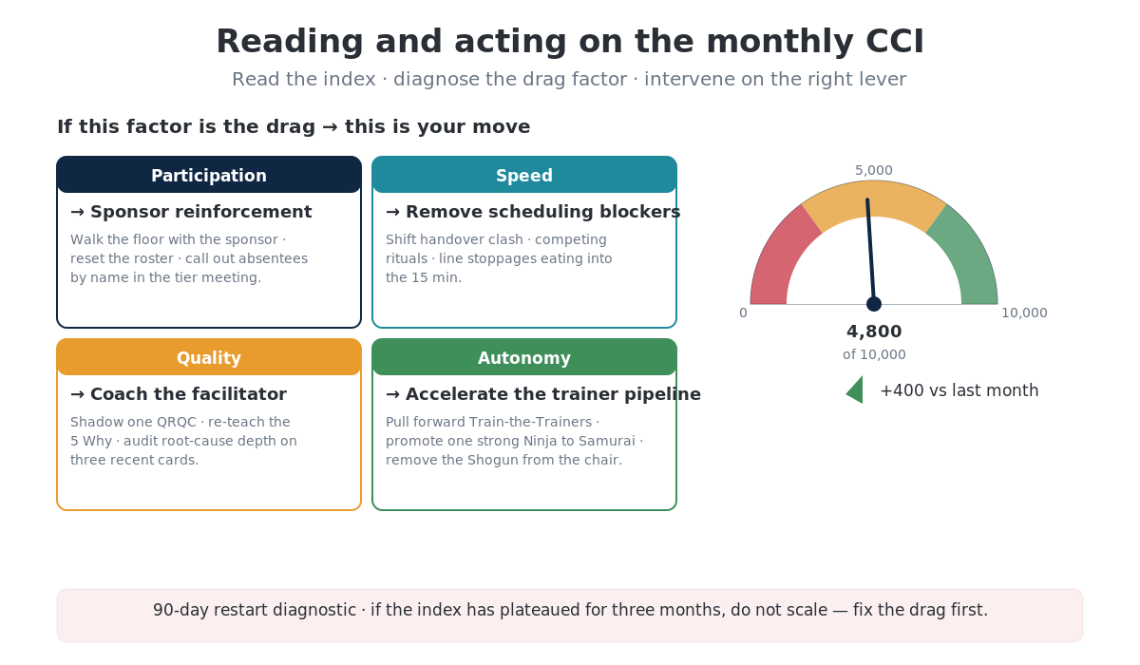

Slide 5
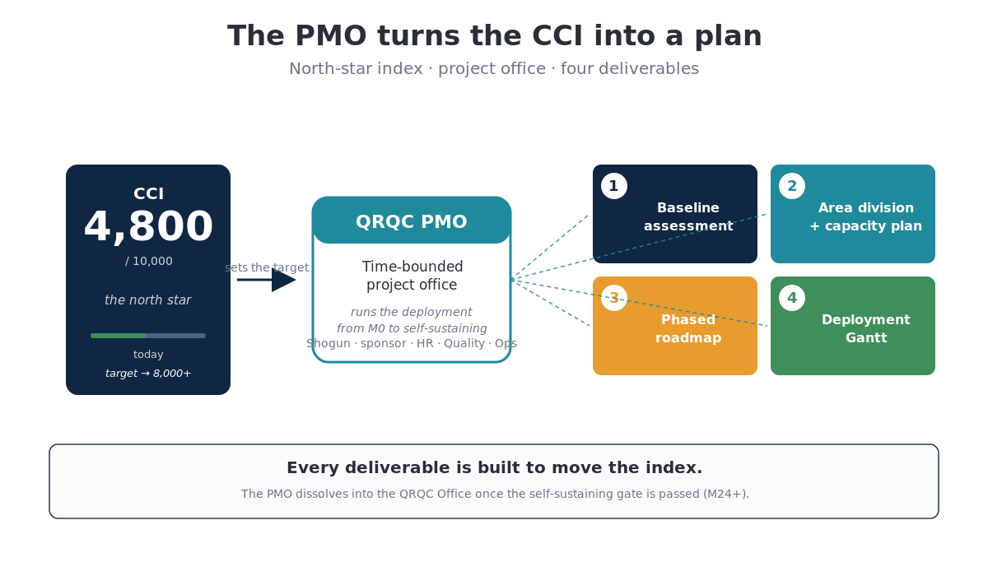

Slide 6
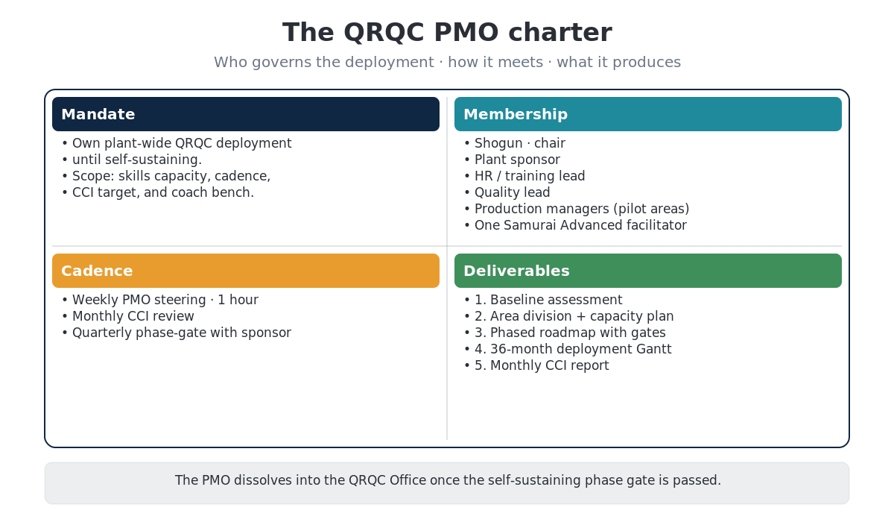

Slide 7
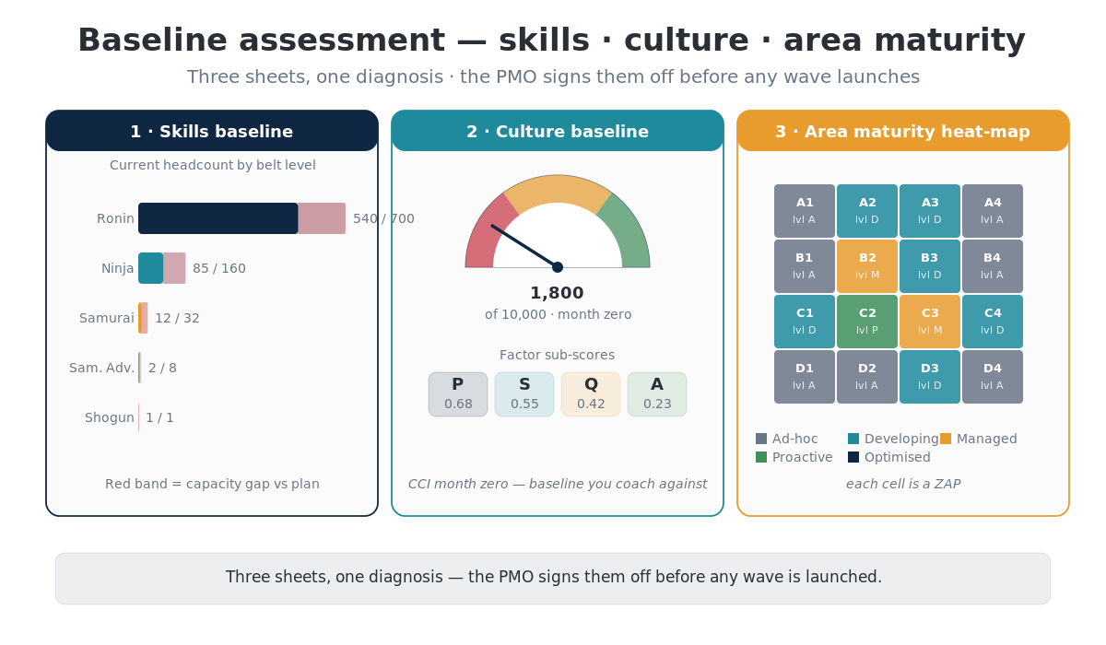

Slide 8
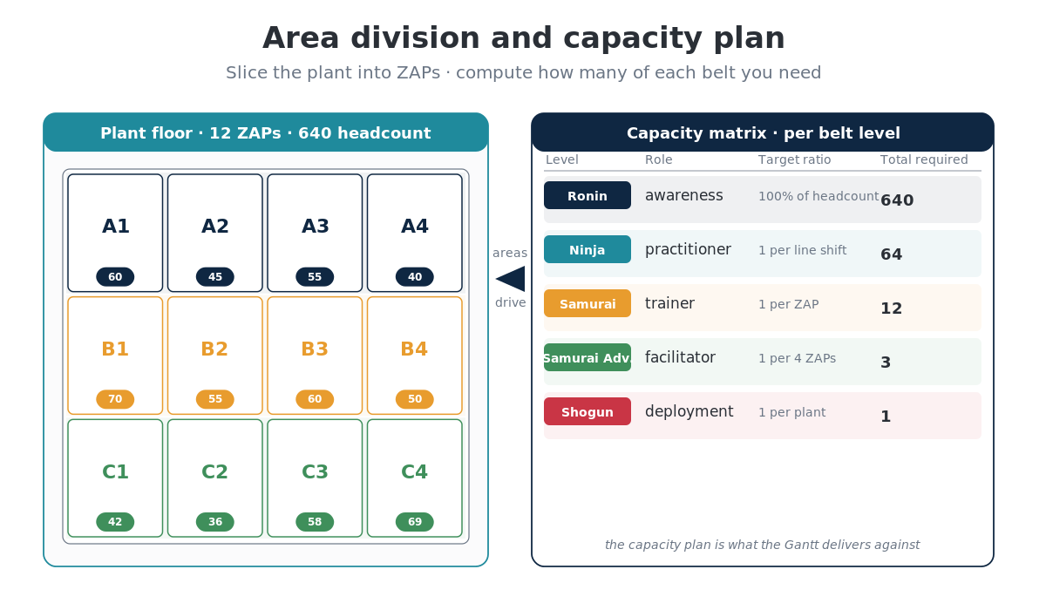

Slide 9
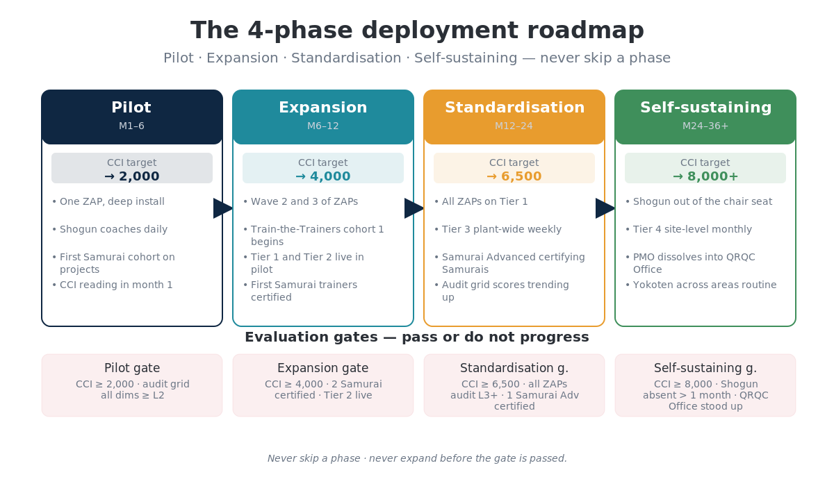

Slide 10
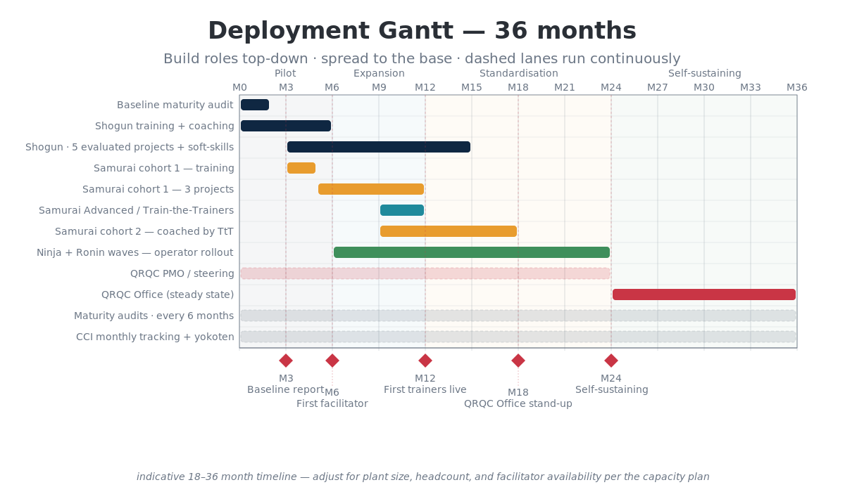

Slide 11
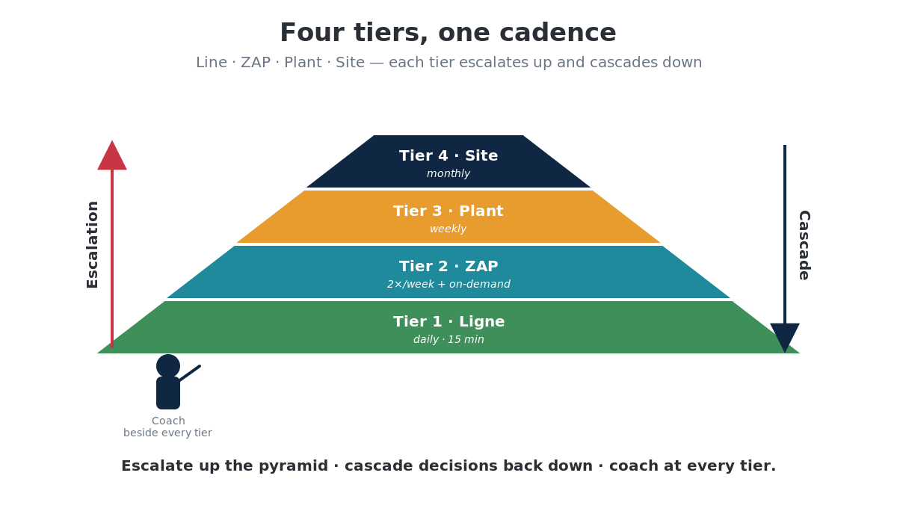

Slide 12
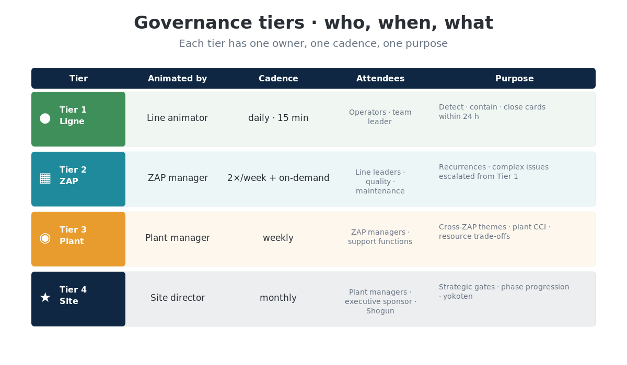

Slide 13
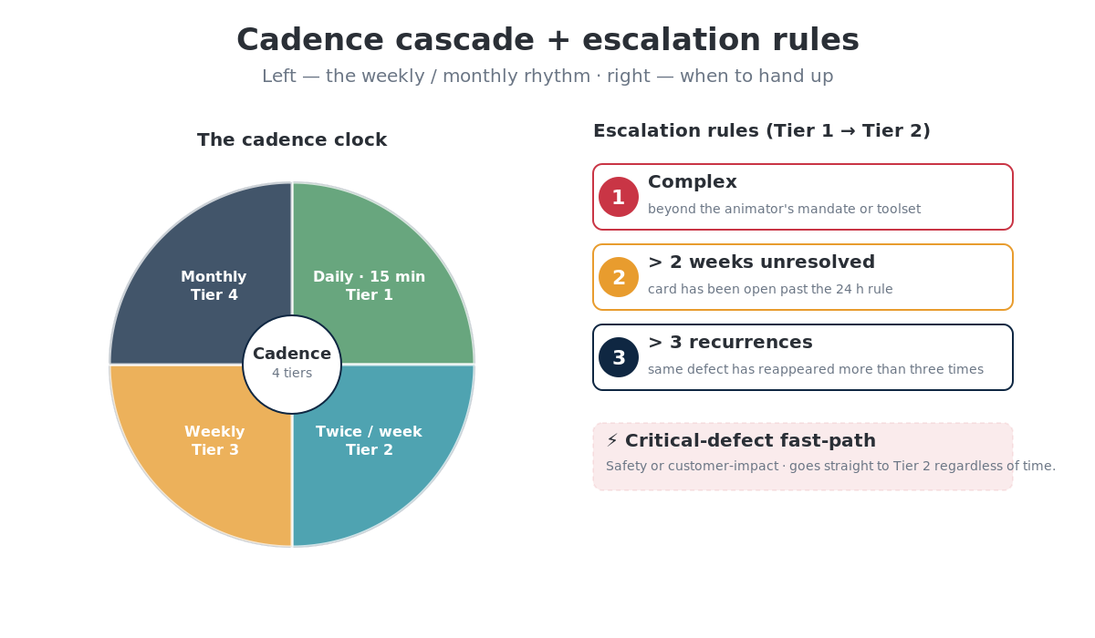

Slide 14
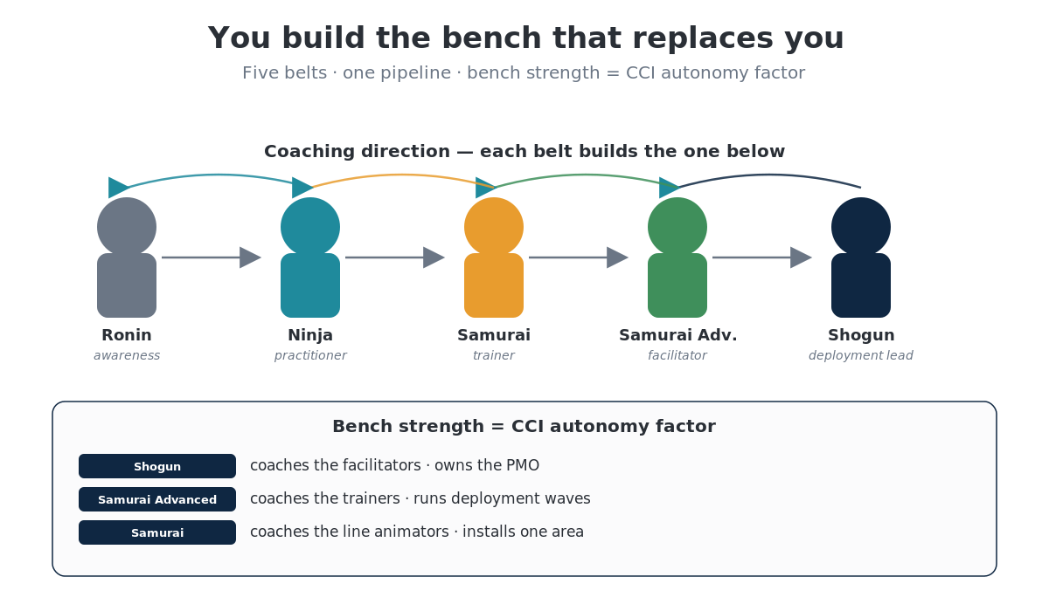

Slide 15
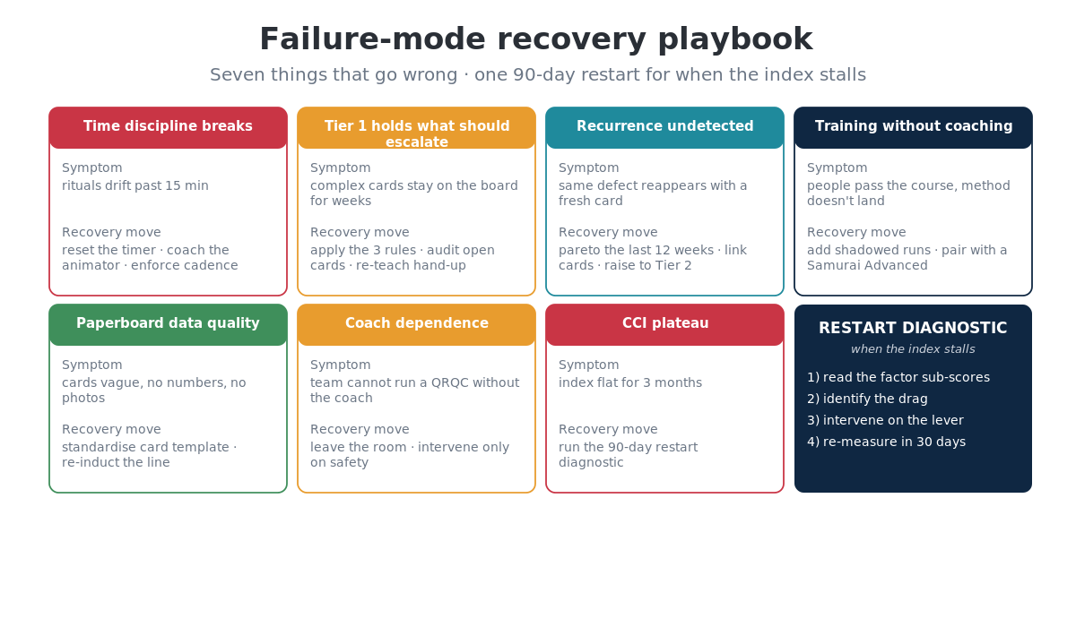

Slide 16
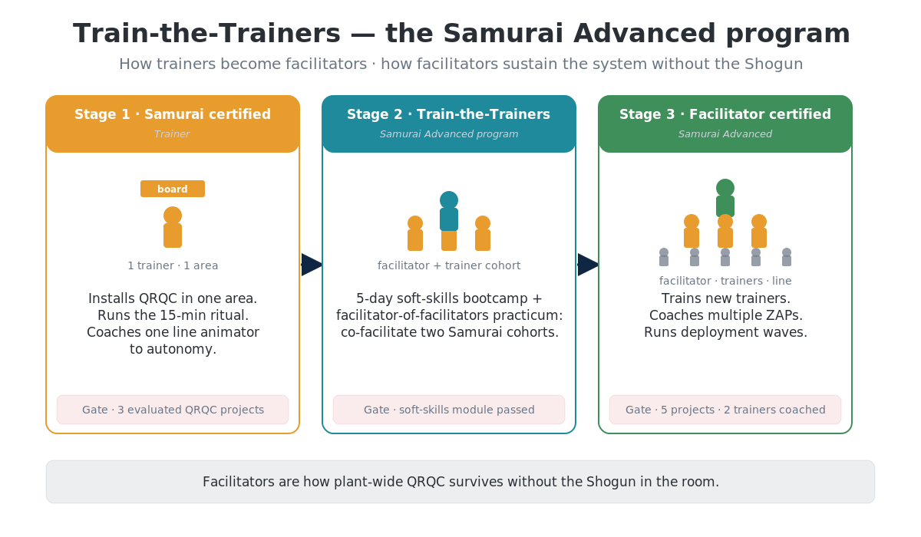

Slide 17
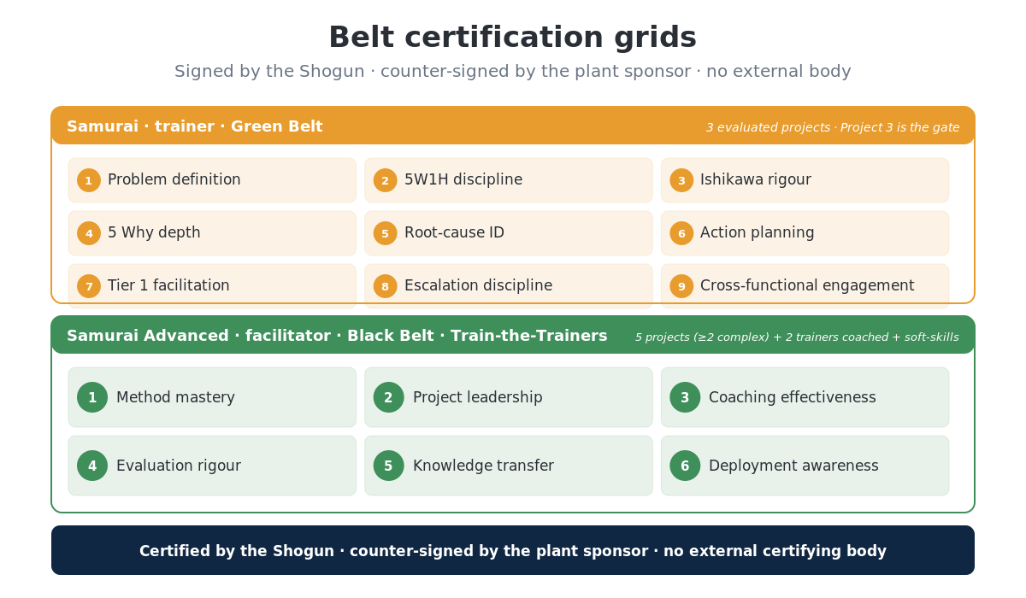

Slide 18
Shogun complete — QRQC 4-belt journey closed
You build the bench that replaces you.
The PMO dissolves into the QRQC Office. The coach bench carries the cadences. The CCI keeps moving. The plant runs QRQC without you in the room — which is the whole point.
leantrainings.com

