Slide 1
Quick Response Quality Control — Samurai
Become the workshop leader who installs QRQC in a production area.
Installing the routine in one area, end to end.
Physical install · social install · 90-min induction · ramp-up ritual · 8-step QC Story · 5×5 audit grid · coaching arc
leantrainings.com

Slide 2
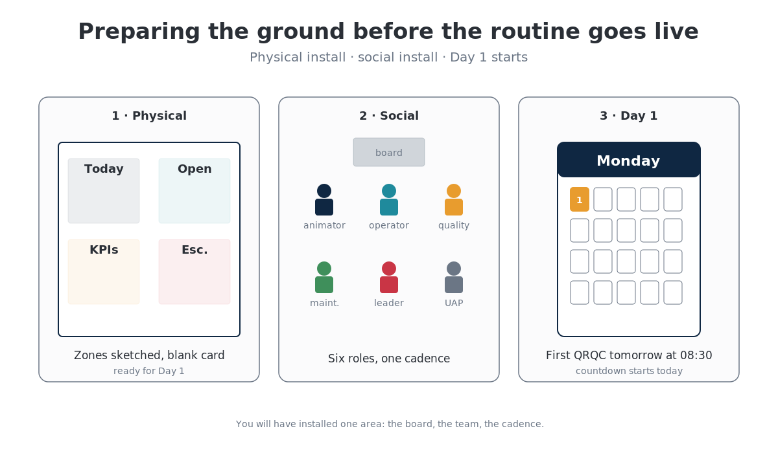

Slide 3
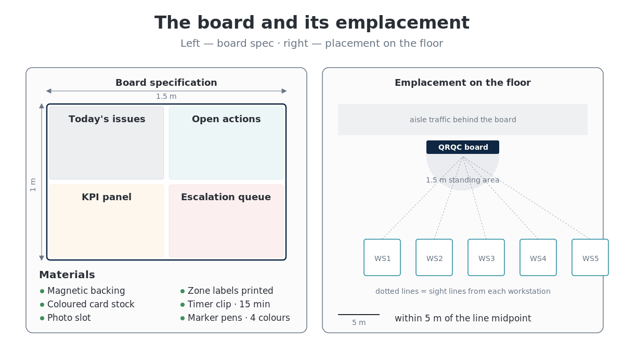

Slide 4
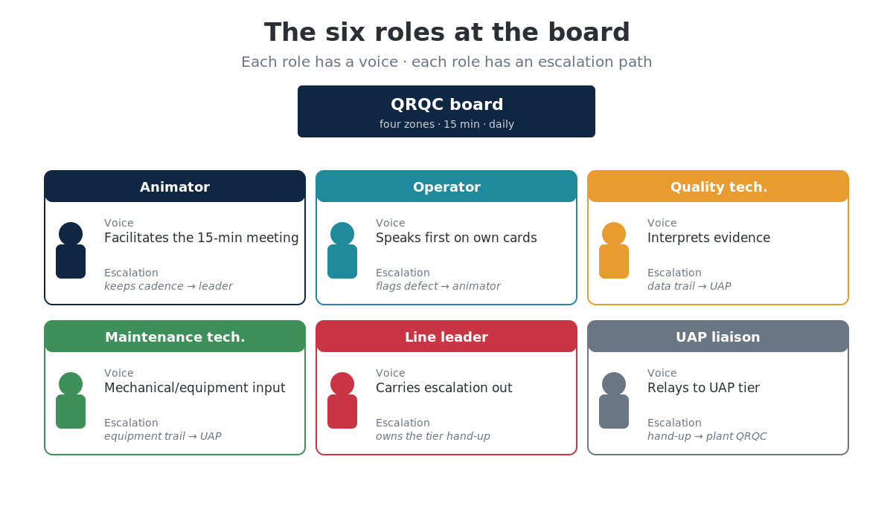

Slide 5
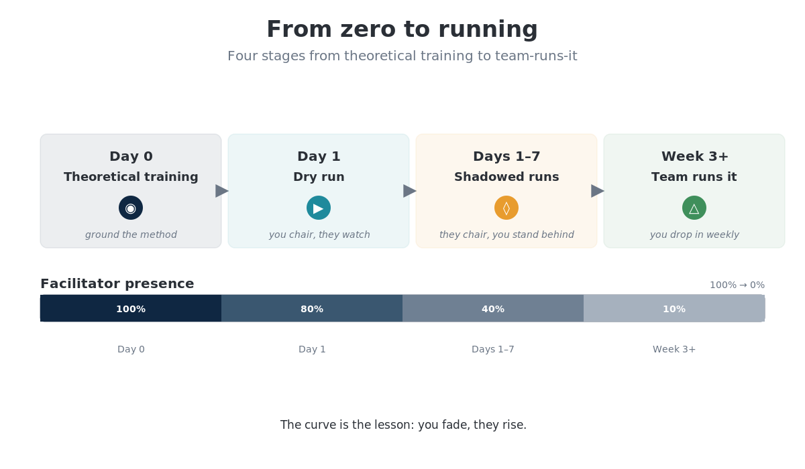

Slide 6
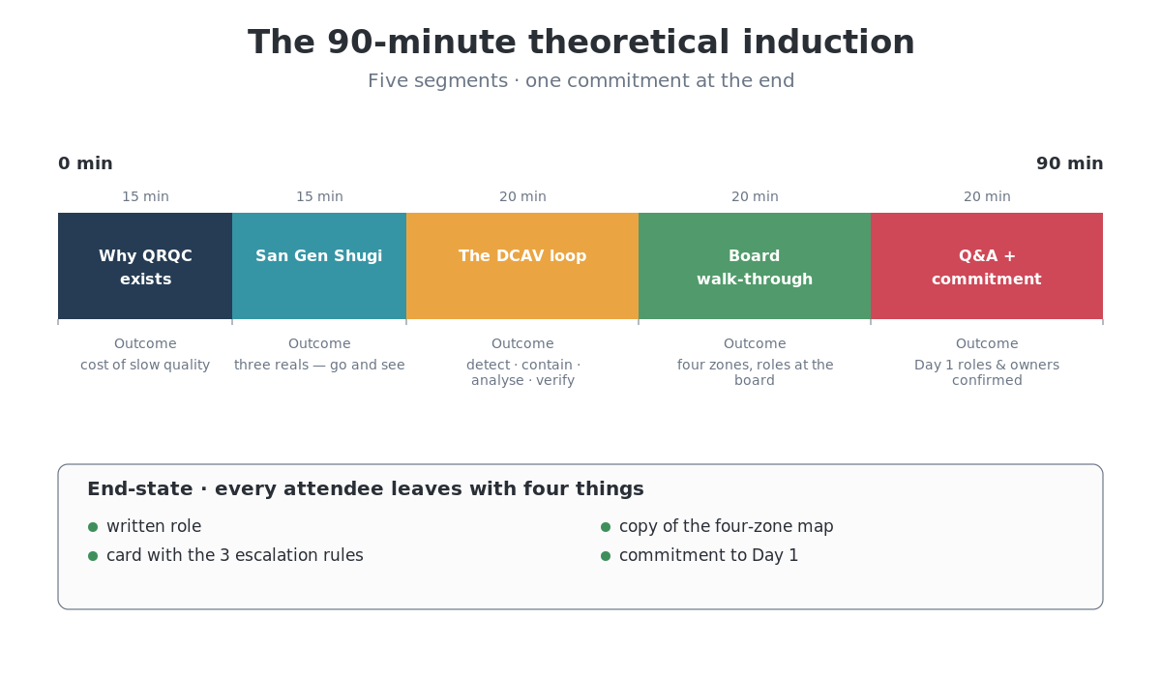

Slide 7
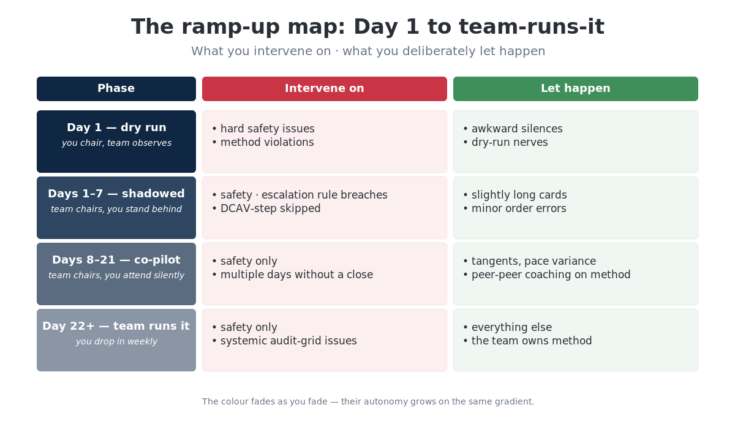

Slide 8
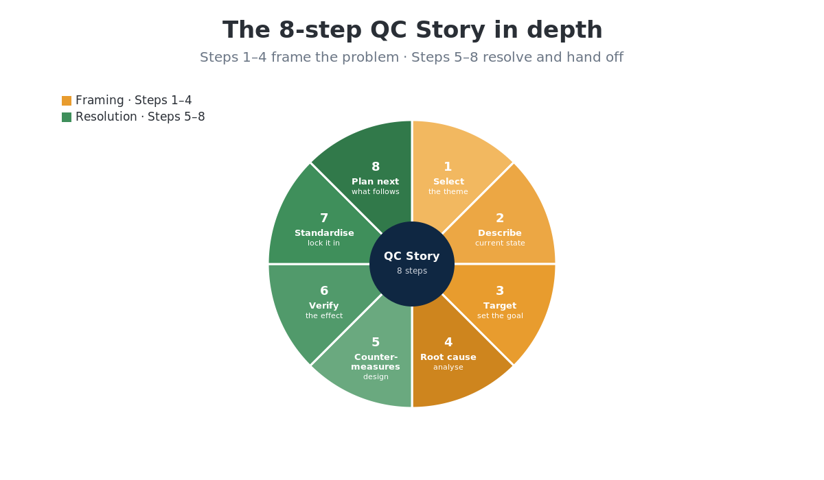

Slide 9
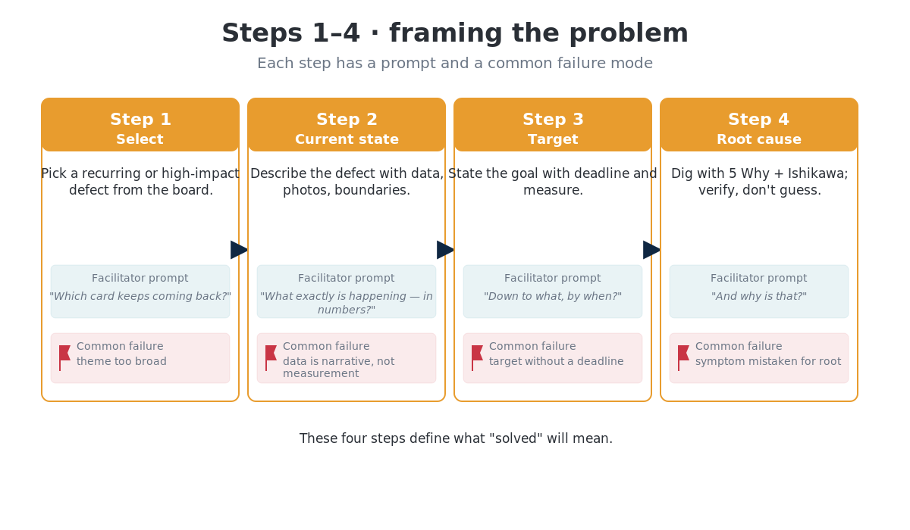

Slide 10
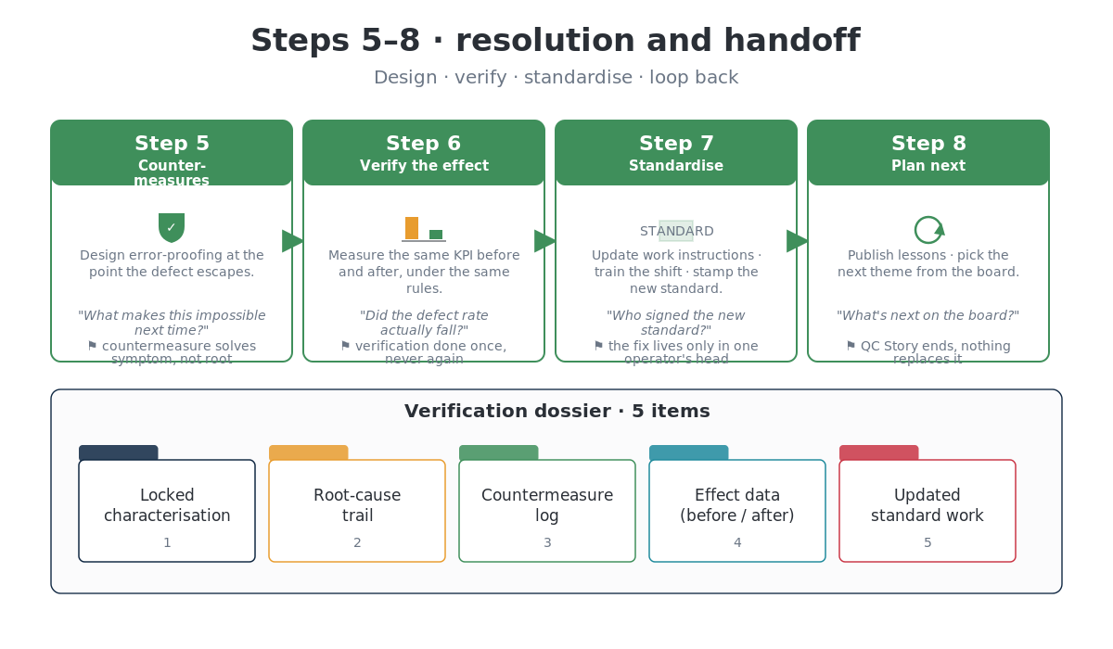

Slide 11
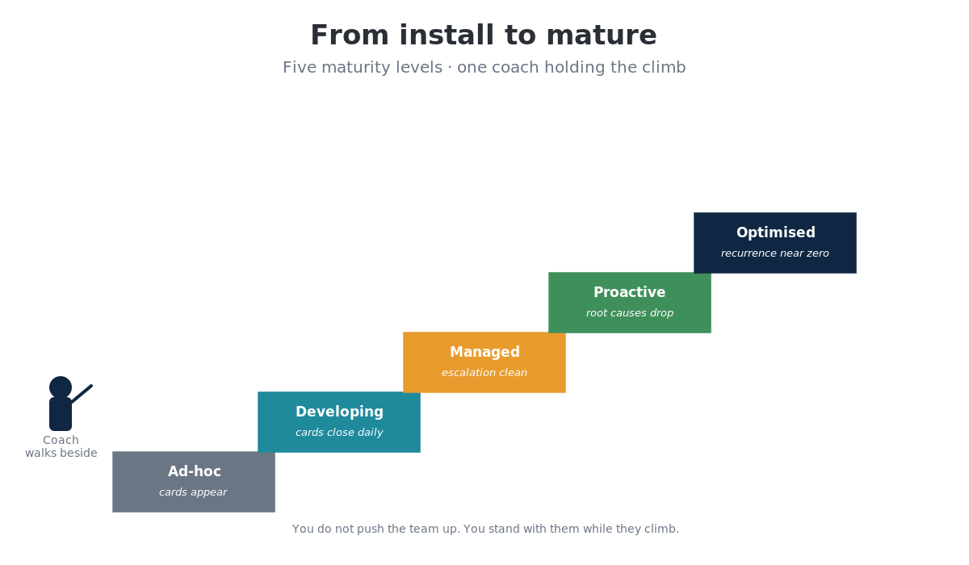

Slide 12
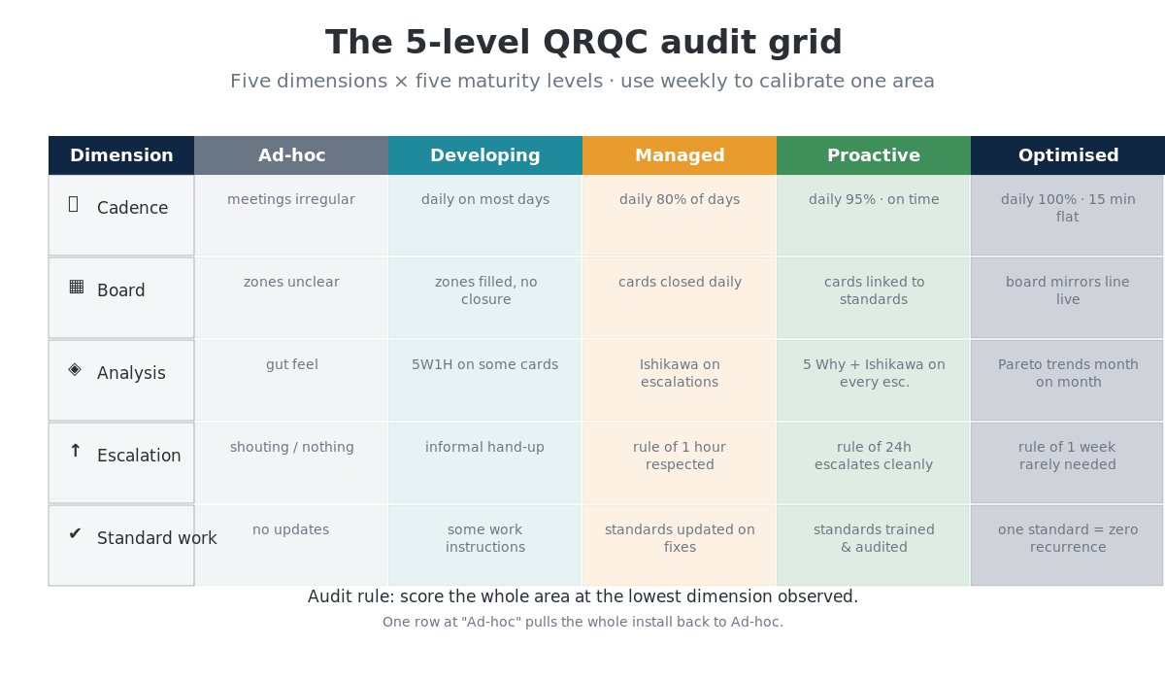

Slide 13
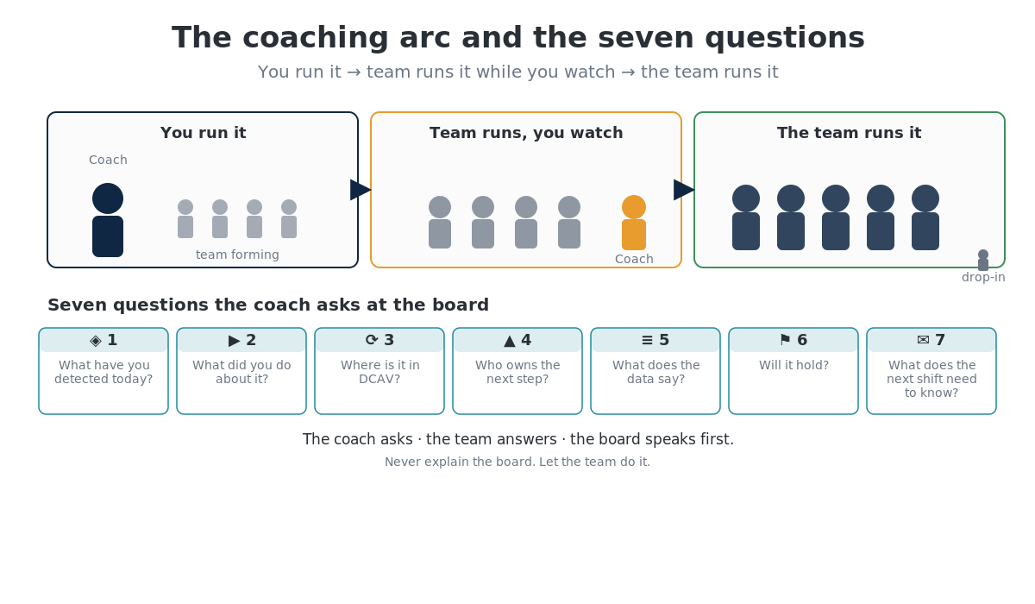

Slide 14
Samurai complete
Next up — Shogun.
Scaling QRQC across every area of the plant, reading the Cultural Change Index, recovering stalled installs, and building the internal coach bench that holds the system without you.
leantrainings.com

