Slide 1
Quick Response Quality Control — Ninja
That four-tool chain is the craft you will leave Ninja able to run.
Running QRQC like clockwork on the line.
Daily Genba cadence · containment at the line · 5W1H → Ishikawa → 5 Why → Pareto → Poka-Yoke · escalation · sustain
leantrainings.com

Slide 2
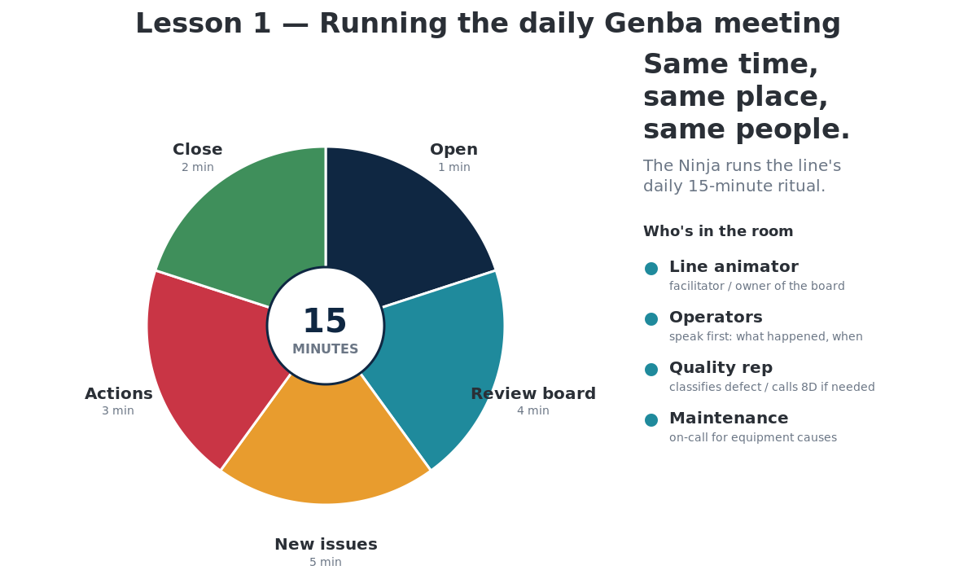

Slide 3
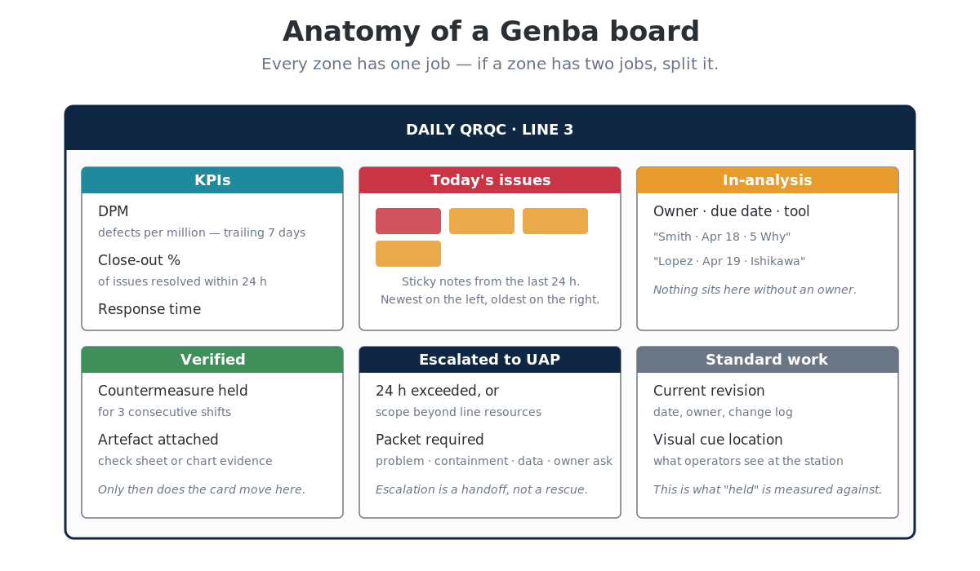

Slide 4
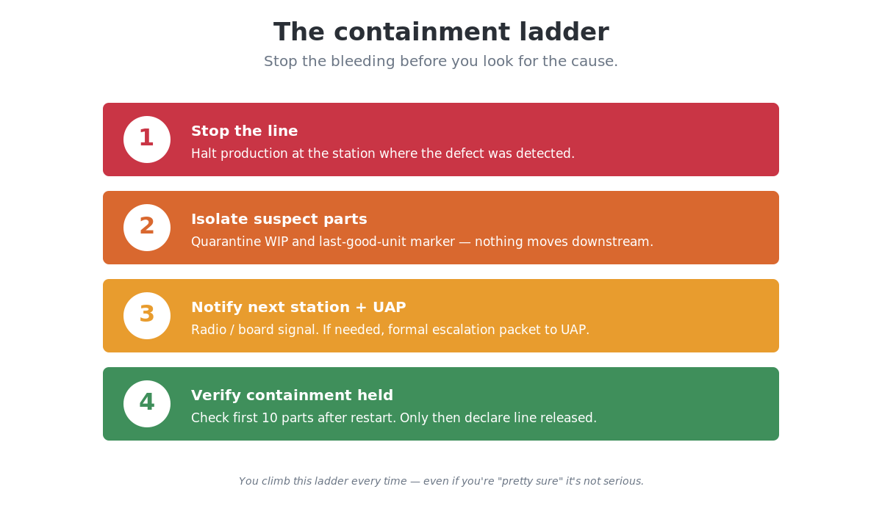

Slide 5
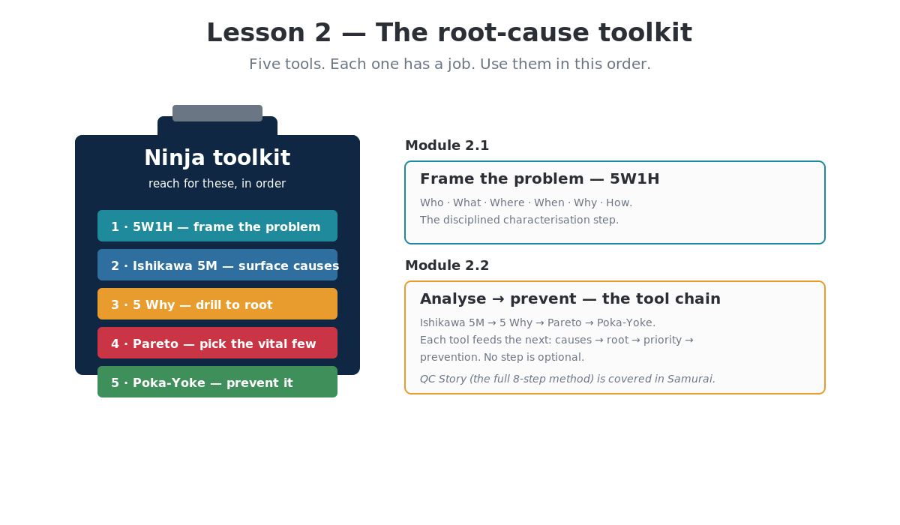

Slide 6
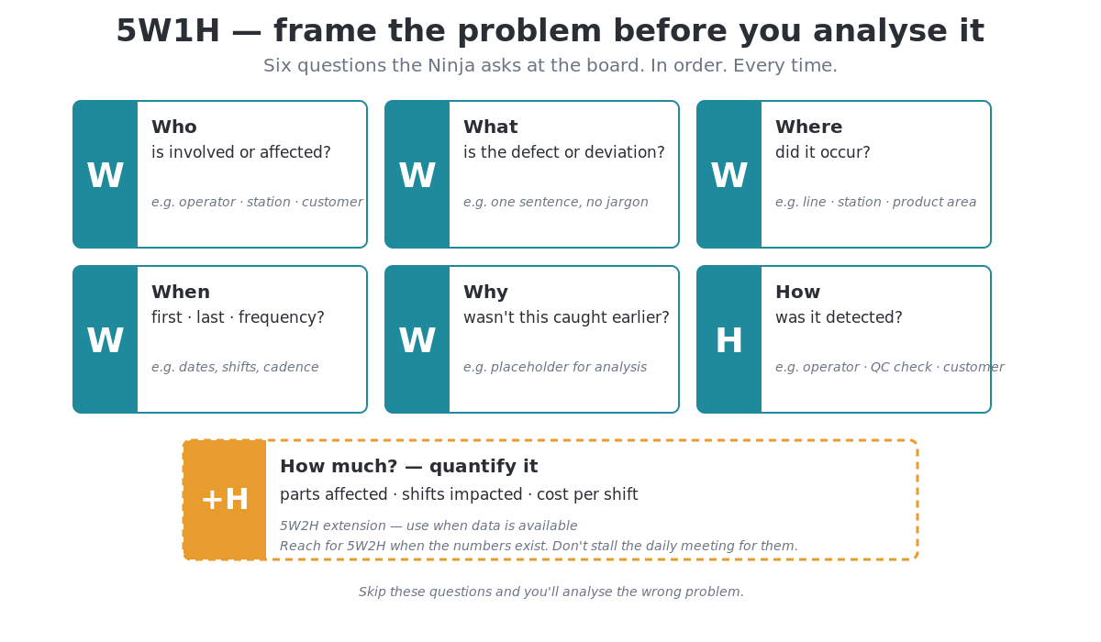

Slide 7
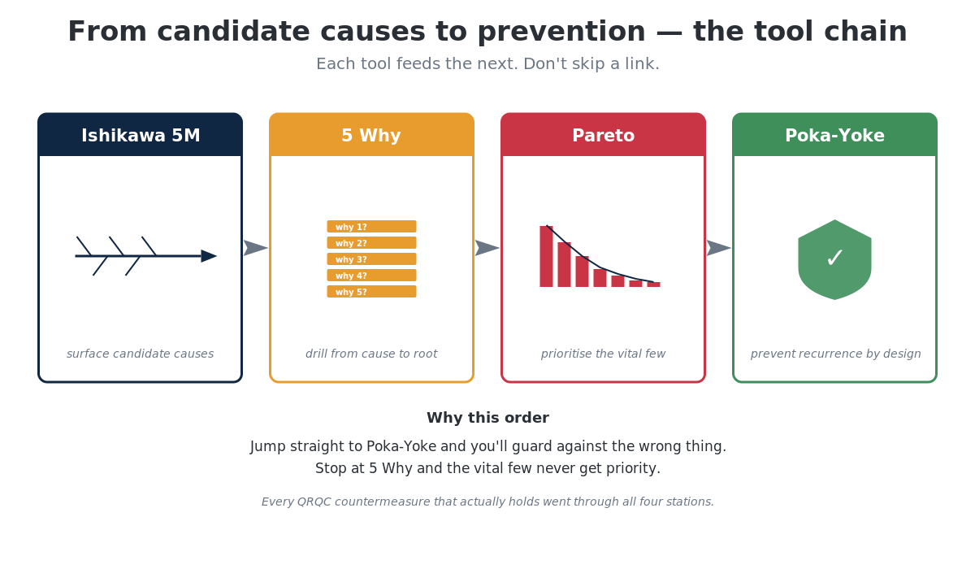

Slide 8
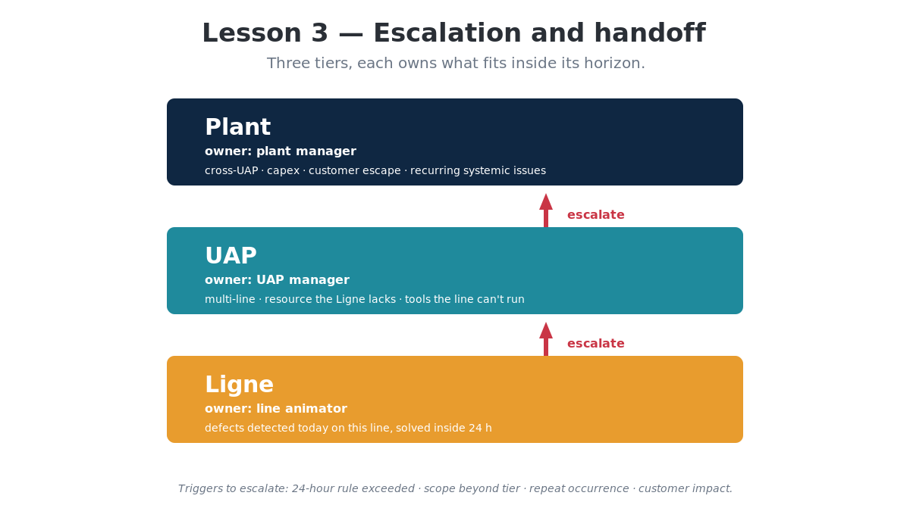

Slide 9
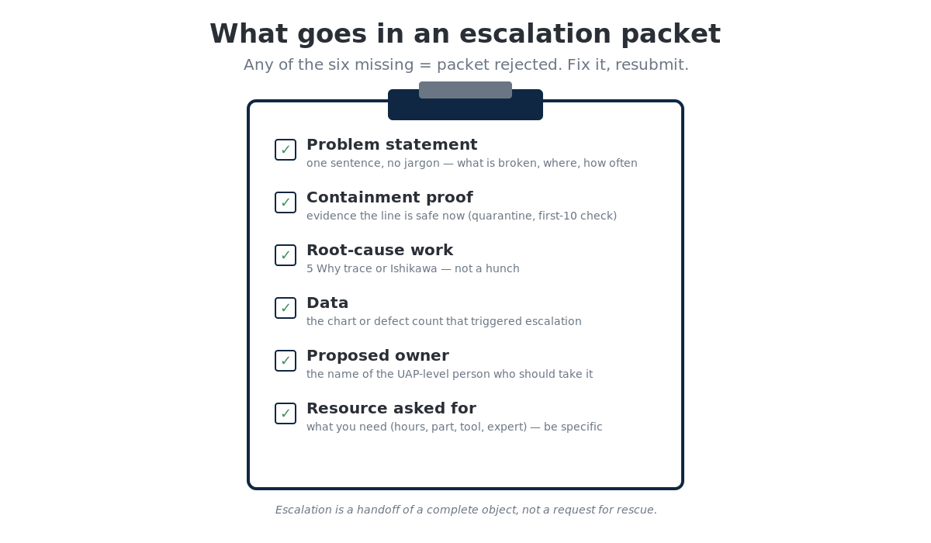

Slide 10
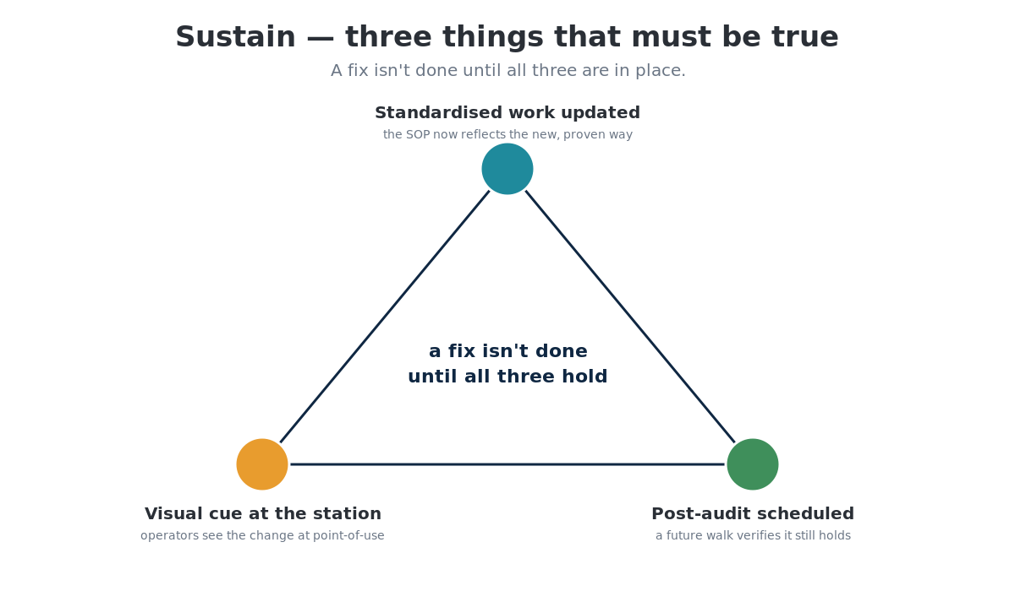

Slide 11
Ninja complete
Next up — Samurai.
Designing the QRQC workshop, running the eight-step QC Story in depth, calibrating against the audit grid, and coaching the line animator to hold the cadence without you.
leantrainings.com

